Slide 1

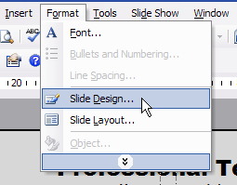
Project Name
QR Code To Website or Paper Goes Here
Senior Design
Lastname1, F., Lastname2, F.,…
Advisor: Chenxi Wang
Background
Architectural Design
This would be a good place for your abstract
This would be a good place holder for your specifications, constraints, initial analyses, conceptual design efforts, and down-select justification.
Figure 1. Figure caption in the bottom
Implementation Details and Test Plan
Default placeholder for your prototyping and test results.
Key Requirements
Prototyping can be interpreted in a broad sense—not only hardware, but high-fidelity simulations.
Table 1. Table caption on top
High-level need as conveyed by the client. Even if your project calls for solving a very narrow, well-defined technical need, highlight its importance in some broader societal context. This is also a good place for reference info, prior art, statistical facts, expert quotes, etc. that justify why this is a problem worth solving.
Header | Header | Header
1 | Table value | Table value
2 | Table value | Table value
Conclusions and Future Work
References
Assessment of how well your chosen design matched the client’s original goals, specifications and constraints. Highlight insights, lessons learned, future plans, etc. Acknowledge your client, sponsors, and other sources of support towards your work.
Liu, S., and Bobrow, J. E., “An Analysis of a Pneumatic Servo System and Its Application to a Computer-Controlled Robot,” ASME Journal of Dynamic Systems, Measurement, and Control, 1988, Vol 110 pp 228-235.
April 2026

